Slide 1



calories counter
View in Power BI
Last data refresh:
3/4/2022 8:58:09 PM UTC
Downloaded at:
3/4/2022 9:43:09 PM UTC

Slide 2
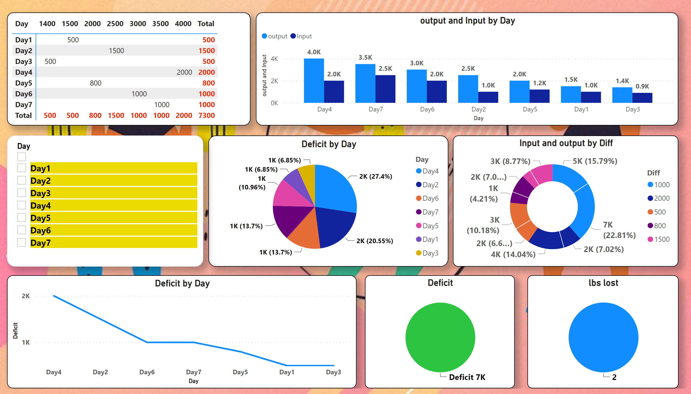
Page 1
Notes:
pivotTable
No alt text provided
pieChart
No alt text provided
donutChart
No alt text provided
clusteredColumnChart
No alt text provided
slicer
No alt text provided
lineChart
No alt text provided
Deficit
No alt text provided
lbs lost
No alt text provided

